Slide 1
Biochemistry
Calcium
Cpc method

Slide 2
Calcium plays an active physiological role in bone mineralisation, neuromuscular excitability, muscle contraction, and blood coagulation. Hypocalcemia can result from chronic renal failure with hypoproteinemia and hypophosphatemia or hypoparathyroidism or vitamin D deficiency (osteomalacia, rickets). The most common cases of hypercalcemia are associated with hyperparathyroidism, tumours and bone metastases, hyperthyroidism or vitamin D overdose. Calciuria has little practical value in the various diagnosis except for the renaltubulopathies. Calcium can be estimated in serum / plasma using o-Cresolphthalein Complexone method.(cpc)

Slide 3
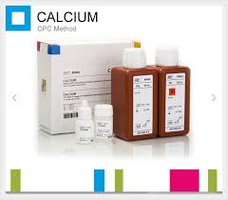

Slide 4
A blood calcium is ordered to screen for, diagnose, and monitor a range of conditions relating to the bones, heart, nerves, kidneys, and teeth. ... If the blood calcium is abnormal, measuring calcium and PTH together can help determine whether the parathyroid glands are functioning normally.

Slide 5
CPC method.
Reagent for quantitative determination of total calcium in human serum and plasma, or urines.
Reaction in 5 minutes at room temperature.
Reading: End Point at 570 nm (550-590).

